Slide 1
Data Integrity Audit Scheme Based on Blockchain Expansion Technology
Team Details :10
1. G.Sairam (21EG505828)
2. J.Dayamani (21EG505831)
3. V.Likitha (21EG505870)
Project Supervisor
Dr. P. Ravinder Rao
Assistant Professor

Slide 2
Introduction
Cloud computing, a distributed model reliant on a shared virtualized computing resource pool, facilitates user access to robust computing and storage capabilities. While it reduces the burden of data storage for users, security, reliability, and privacy. Ensuring the integrity of outsourced data becomes critical, given potential risks like data damage or deletion by cloud service providers (CSP). Current auditing schemes face shortcomings. Blockchain emerges as a solution with decentralization, tamper resistance, and traceability properties. However, its rapid growth poses maintenance challenges. A proposed data integrity verification scheme, utilizing blockchain expansion technology, addresses these issues through a protocol based on plasma smart contracts.

Slide 3
Problem Statement
The increase in cloud data outsourcing faces a critical hurdle – ensuring data integrity. In the existing system, various methods like smart contracts, decentralization, and deduplication have been proposed to ensure data integrity in cloud storage. However, these lack robust data auditing techniques and effective hashing mechanisms. For instance, replacing Third Party Auditors (TPA) with smart contracts, falls short in resisting replay attacks by Cloud Service Providers (CSP). Some expansion schemes address blockchain scalability but overlook crucial elements like data auditing techniques and hashing processes, leaving potential vulnerabilities.

Slide 4
Problem Illustration
Imagine a scenario where a company uploads sensitive business data to the cloud for storage and processing. There's a risk that the CSP might tamper with or delete the data, either accidentally or intentionally. Moreover, traditional auditing methods, such as Third Party Auditors (TPAs), are not entirely efficient, as they may be prone to human error or manipulation.
To address these concerns, various methods are proposed in the existing system, such as using smart contracts, decentralization, and deduplication(eg:replacing TPAs with smart contracts). While these methods offer some level of assurance but still lack in maintaining integrity of data.
Furthermore, some expansion schemes in blockchain, which aim to address scalability issues, overlook crucial elements like data auditing techniques and hashing processes.

Slide 5
Proposed Method
The proposed system of this project introduces a data integrity audit protocol based on plasma smart contracts, leveraging plasma sub-chains to reduce main chain storage pressure. Batch auditing is implemented for efficient multi-task processing, employing non-interactive audits. A reward pool mechanism ensures correctness, and security analysis.

Slide 6
Proposed Illustration
Let's consider a company, which uses cloud to store and process sensitive data. However, it faces issues regarding the integrity and security of its outsourced data.
In the existing system, various security measures are used such as encryption and access controls to protect its data. However, these measures do not provide complete assurance. Company’s audit team audits manually to verify data integrity, which is time-consuming which also lacks transparency.
The proposed scheme integrates plasma smart contract to ensure the integrity of data. These smart contracts establish network of plasma sub-chains, interconnected with the Ethereum main chain. Each plasma sub-chain serves as a secure repository for company's data, enabling tamper-resistant storage and traceability.

Slide 7
Experiment Environment
Hardware System Configuration:
Processor: Pentium IV
RAM: 4 GB (minimum)
Hard Disk: 20 GB
Software Requirements:
Operating System: Windows XP
Programming Language: Java, J2EE
Blockchain Framework: Ethereum
Integrated Development Environment (IDE): Netbeans IDE.
Database: MySQL
Web Development: HTML, CSS, and JavaScript

Slide 8
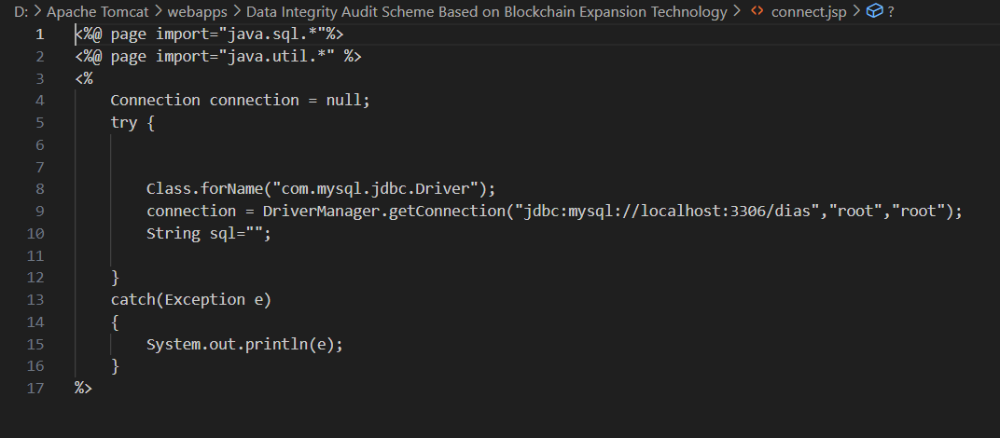
Experiment Screen shorts
Connecting to Database:

Slide 9
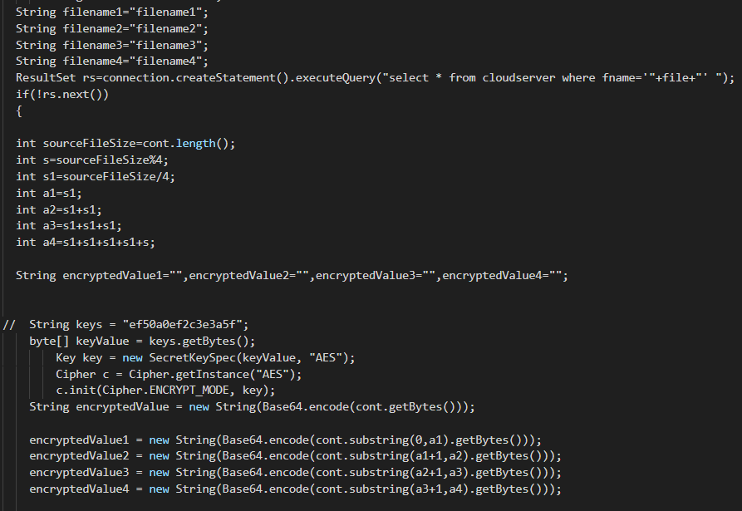
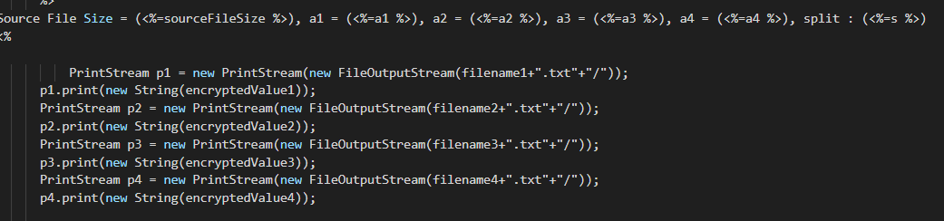
Experiment Screen shorts
Inclusion of Blockchain :

Slide 10
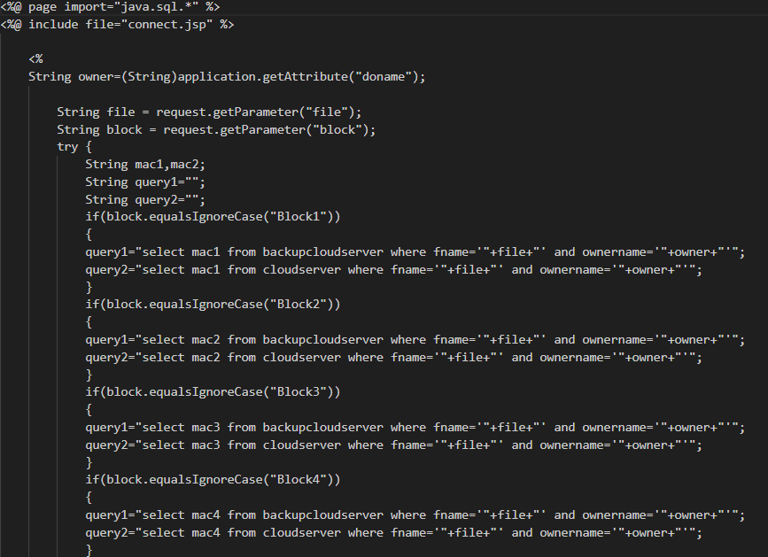
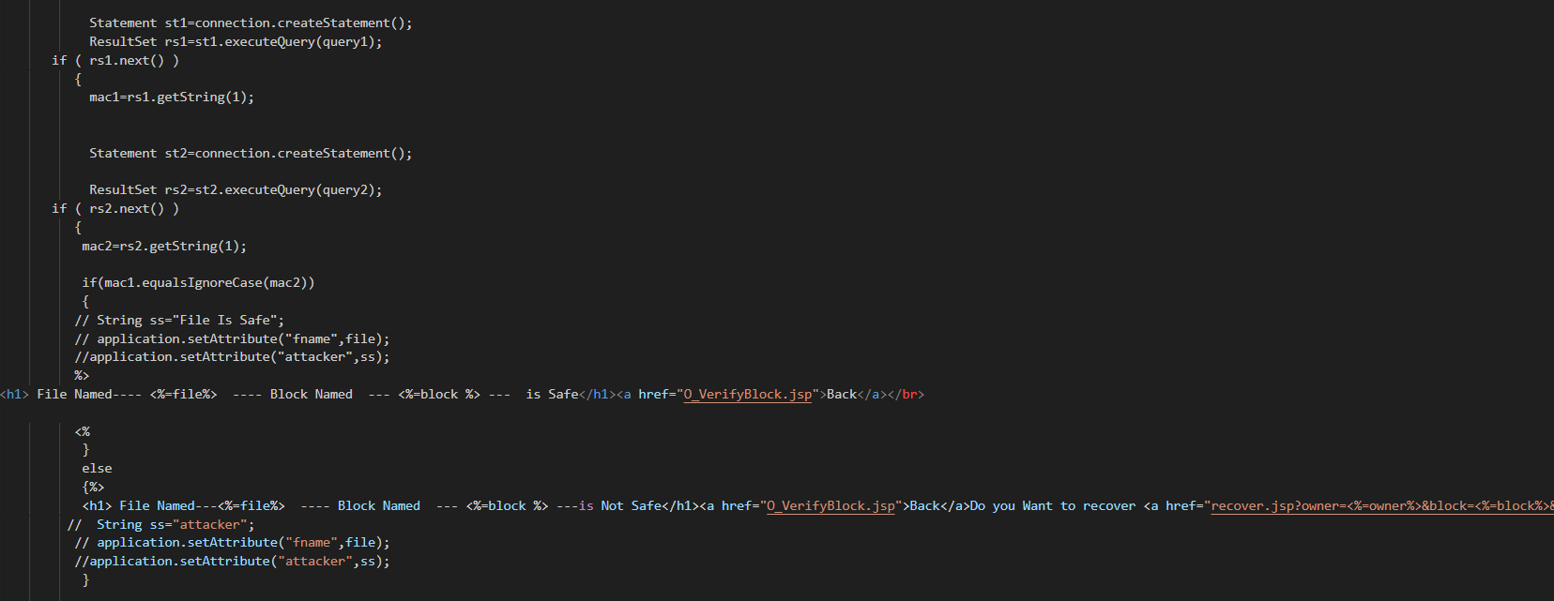
Experiment Screen shorts
Verifying the Contents of the Block:

Slide 11
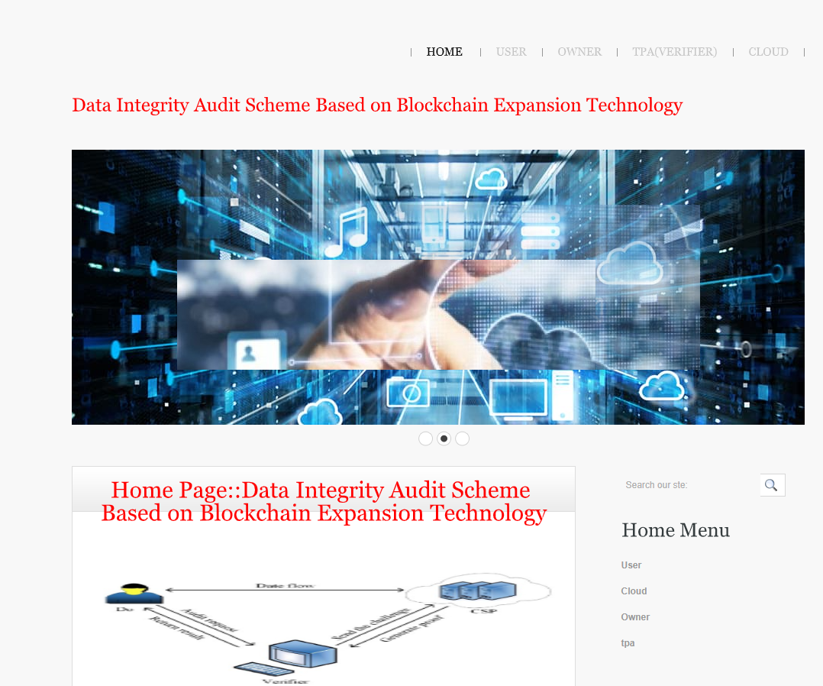
Experiment Results
Homepage:

Slide 12
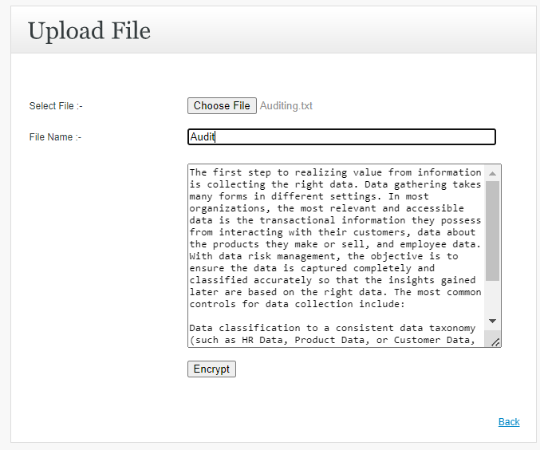
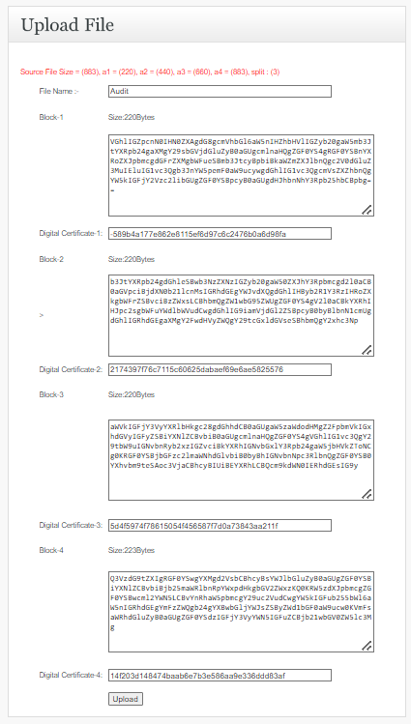
Experiment Results
Data in Blockchain:

Slide 13
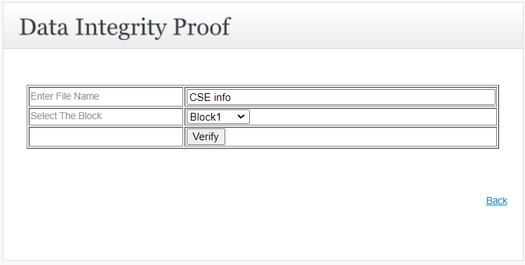
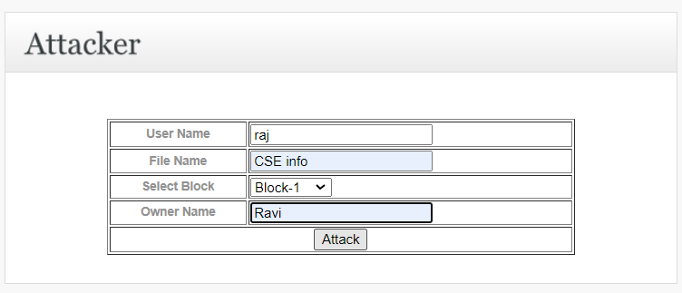
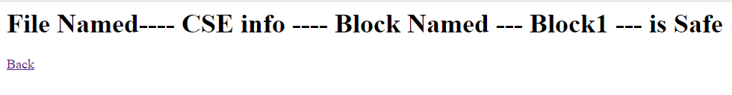
Experiment Results
Verifying Block :

Slide 14
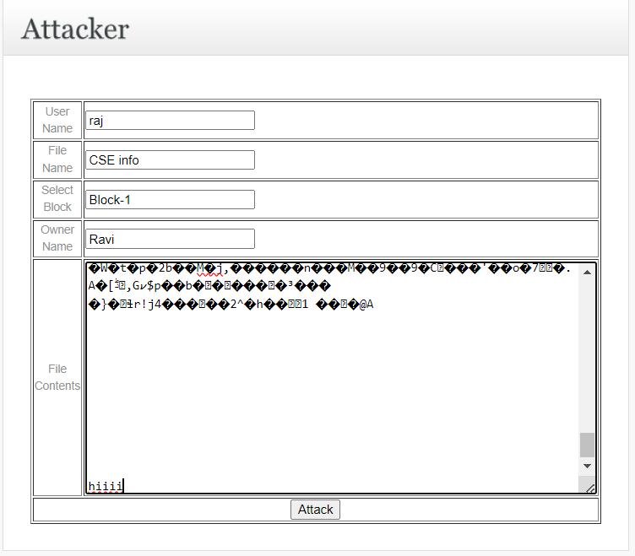
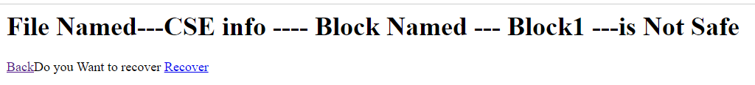

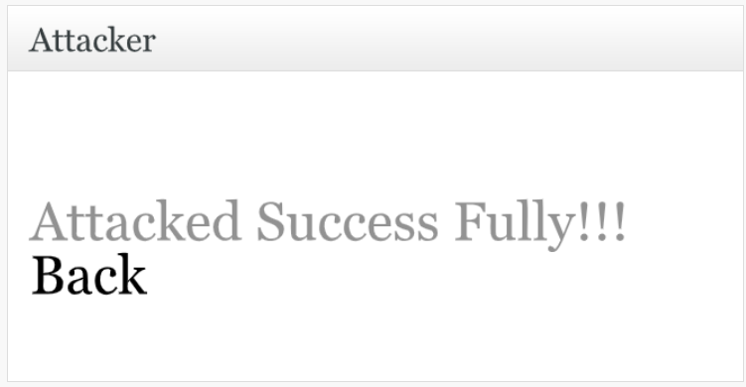
Experiment Results

Slide 15
Finding
The proposed data integrity system based on blockchain expansion technology presents a promising approach to enhancing data integrity, reducing costs, and improving efficiency in cloud storage environments.
Smart contracts are deployed on both the main chain and sub-chains, enabling users and cloud service providers (CSP) to collaborate efficiently.

Slide 16
Justification
1.What are parameters improved by your method
i)Scalability
ii)Cost Effectiveness
iii)Security Efficiency
2.why your parameter values improved?
The proposed system's design and features are aimed at optimizing performance, reducing costs, enhancing security, and improving user experience, which collectively contribute to the improvement in parameter values compared to existing blockchain-based data integrity audit schemes.

